Slide 1


MSc. Lorena Radavci
Department of Finance and Risk Management
The University of Sheffield
City College, International faculty of University of Sheffield
Title: Modelling and Forecasting Volatility in Stock Markets using GARCH Models: A Comparison between Emerging and Developed Economies
July, 2021

Slide 2

Contents
Introduction
Methodology
Data Analysis and findings
Conclusion

Slide 3
Introduction
Monetary policy making
Capital asset pricing
Applications in finance
Risk management
Portfolio management
Option pricing
Volatility is a statistical measure of the dispersion of returns for a given security or market index (Kuepper, 2020)

Slide 4
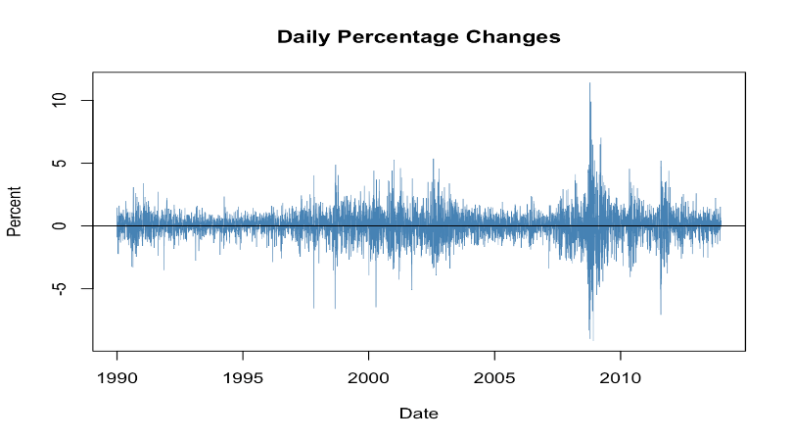
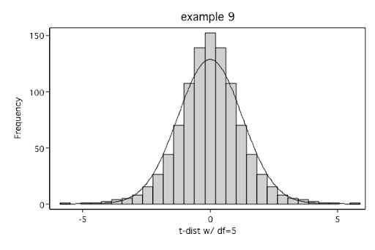
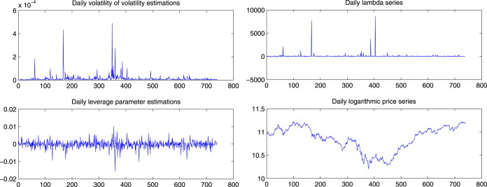
Characteristics of financial data
Volatility clustering
Leverage Effect
Volatility Feedback
Leptokutosis

Slide 5




ARCH Model
GARCH Model
Autoregressive Conditional Heteroscedasticity (ARCH) was first introduced by Engle (1982).
Bollerstev (1986) and Taylor (1986) have generalized the ARCH model by including lagged values of the conditional variance and developed the Generalized Autoregressive Conditional Heteroscedasticity model (GARCH).
ARCH (1,1):
GARCH (1,1):
GARCH (p,q):
ARCH (p,q):
-the conditional variance
-the long-term average component of variance
-the sensitivity of conditional volatility to market shocks
β - the persistence of conditional volatility

Slide 6
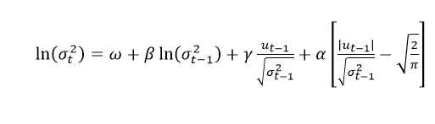


EGARCH Model
GJR-GARCH Model
APARCH Model
The EGARCH model was first presented by Nelson (1991), which captures the asymmetric effect. It is expressed as follows:
Another model which accounts and measures the asymmetry is presented by Glosten et al. (1993) and it is called the GJR-GARCH model or TGARCH model. It is expressed as follows:
Asymmetry can be captured also by Asymmetric Power ARCH (APARCH) model presented by Ding et al. (1993), where the power parameter is estimated rather than imposed, and the optional parameter ϒ is used to capture the asymmetry as follows:
- 𝛾 represents the leverage effect.
- 𝛾 represents the leverage effect.
- 𝛾 represents the leverage effect.

Slide 7


CGARCH model
Another model will be considered in this paper to enrich the research and is called the component GARCH model, introduced by (Engle and Lee, 1999) and (Ding and Granger, 1996)
The short-run transitory effect:
The long-run impact of the variance innovation:

Slide 8


Distribution of the error term
Normal distribution:
Student-T distribution:

Slide 9
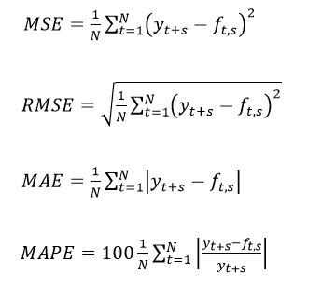
Comparison criteria
This paper uses four different loss functions or accurate statistics such as Mean Squared Error (MSE), Root Mean Squared Error (RMSE), Mean Absolute Error (MAE) and Mean Absolute Percentage Error (MAPE).

Slide 10
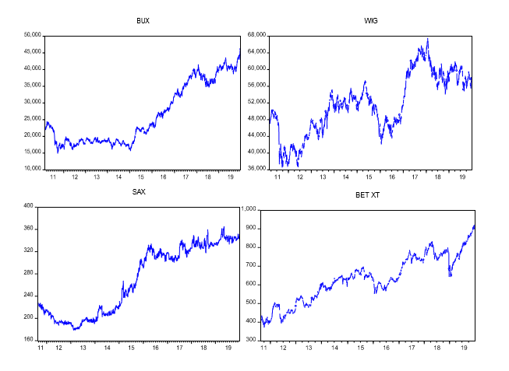
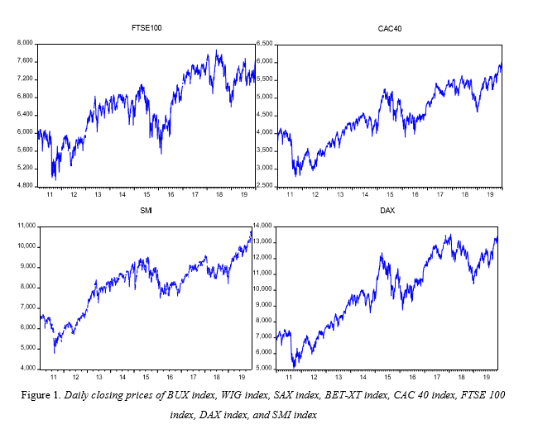
Data collection and analysis
- Period from 2011 until 2020
Figure 1. Daily closing prices of BUX index, WIG index, SAX index, BET-XT index, CAC 40 index, FTSE 100 index, DAX index, and SMI index

Slide 11
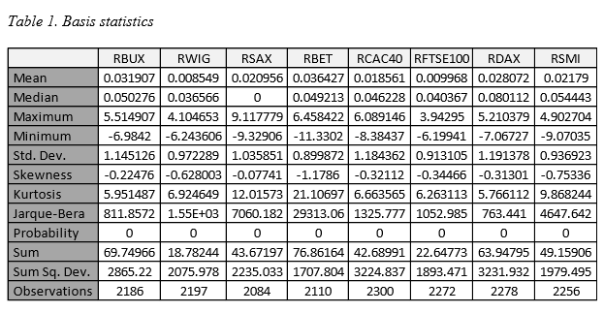
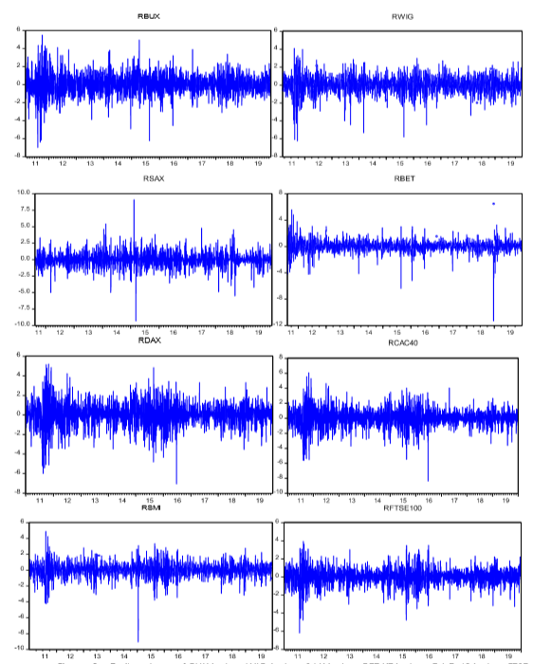
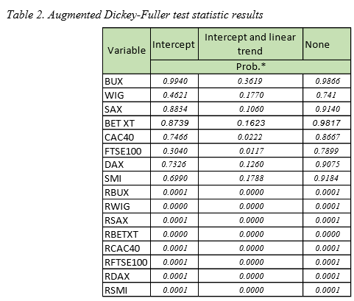
Table 3. Stock returns

Slide 12
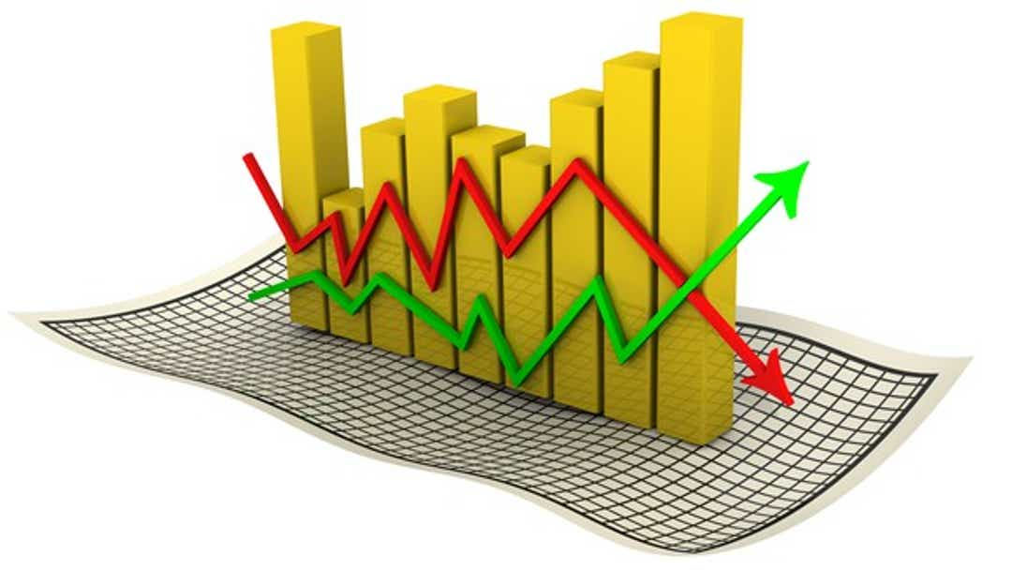
Steps for Modelling
    Confirm evidence of heteroscedasticity in stock returns using ARCH-LM test by Engle (1982)
    Selection of the adequate ARMA(p,q) model for the mean equation based on Schwarz criterion
    Estimation of GARCH models
    Processing the ARCH-LM and Correlogram Q-statistics tests to improve the accuracy of the models
    Forecasting

Slide 13
Estimation results for GARCH models
Table 4. The in-sample results
Comparison criteria:
Schwarz criterion
Log Likelihood function
Akaike info criterion

Slide 14
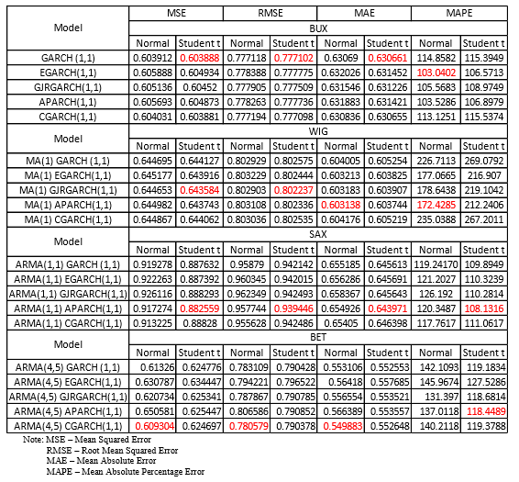
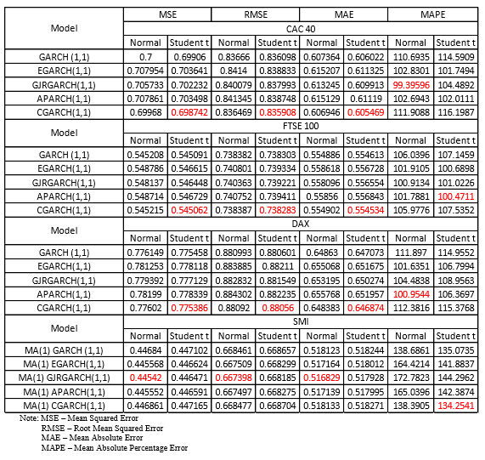
Evaluation of out-of-sample volatility forecast

Slide 15
Conclusion
It can be concluded that the asymmetric models of GARCH-family outperformed the symmetric models in capturing the volatility of stock return in all markets;
All stock markets are characterized with volatility clustering, asymmetric effect, heavy tails, and leptokurtosis
The negative news have a greater impact on volatility than the positive news in all markets, with one exception for Slovakian Stock market;
The volatility shocks are quite persistence except in the Slovakian stock market;
The asymmetric volatility is evidenced in all markets. However, the developed markets display higher leverage effect in comparison with emerging ones;
In general, it seems like the APARCH model is more suitable to forecast the stock return volatility for emerging markets and the CGARCH for developed markets;

Slide 16

THANK YOU FOR YOUR ATTENTION!

